Slide 1
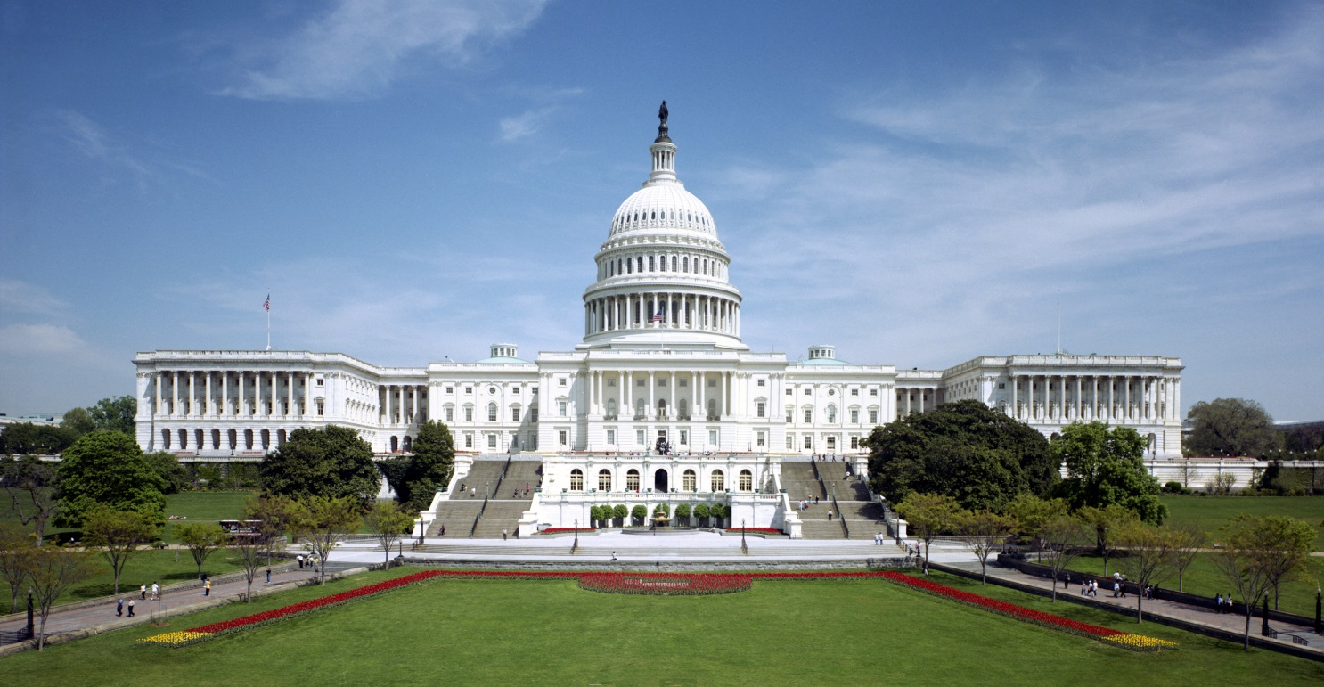
AP Government Legislative Branch
SENATE
HOUSE
US Capitol – Senate on north side, House of Representatives on south side
Notes:
Congress is the center of policymaking in the United States, but the decentralization of power within it and between the branches makes it difficult to get things done. Here President Barack Obama delivers his 2012 State of the Union address before a joint session of Congress.

Slide 2
Big Idea
The system of checks & balances in Congress helps keep an appropriate balance between majority rule and minority rights

Slide 3
First Things First
Congress = Legislative Branch = Senate and Houses of Representatives
If you read or hear the Two Houses of Congress, they are referencing the Senate and the House

Slide 4
Houses of Congress
Great Compromise –
Bicameral- two house legislature
Senate with 2 per state; House based on pop.
House –
2 year terms, 435 total seats
all seats up for reelection at the same time
Constituents
directly elected by their districts
Mist representatives are responsible for a relatively small geographic area
Senate –
6 year terms, 100 total seats
Constituents: originally selected by state legislatures, but now elected directly by their state. Elections staggered so only about 1/3 up for election each national general election
17th Amendment (1913)
provided for the direct election of US Senators
Notes:
Being a member of Congress isn’t an easy job. It takes a considerable amount of time, trouble, and money to get elected, and reelected—and the reward for all that effort is a hectic job shuttling between your constituency and Capitol Hill, being expected to solve everyone’s problems but lacking the individual power to change much of anything.

Slide 5
Members
Not a glamorous job, but there are perks
Power
$174,000 annual salary
Generous retirement and health benefits
Constitutional requirements
House: 25, citizen for 7 years
Senate: 30, citizen for 9 years
Reside in state
435 Representatives; 100 senators
Notes:
Being a member of Congress isn’t a glamorous job, but it has its perks. Members of Congress receive an annual salary of $174,000, along with generous retirement and health benefits—but most attractive of all, they have the power to make important public policy decisions.
The Constitution specifies that members of the House must be at least 25 years old and American citizens for 7 years, that senators must be at least 30 and American citizens for 9 years, and that all members of Congress must reside in the state from which they’re elected. There are 100 senators, two from each state, and 435 representatives in the House.
Members of Congress tend to be lawyers, and to come from relatively wealthy backgrounds. Minorities and women are underrepresented.

Slide 6
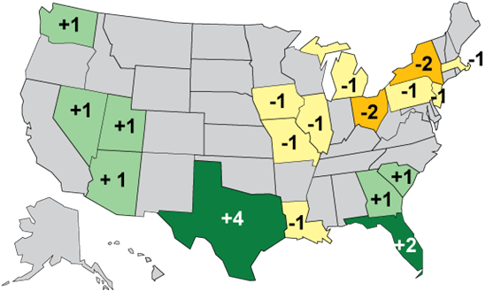
Reapportionment
Rustbelt
redistribution of representatives among states based on population change, which is done for the House after each census
Sunbelt
2010
Notes:
Recent population growth in the Sunbelt, California, Texas, and Florida gave those states more seats
Northeast and Midwest states have lost seats in the House (Wisconsin lost one of its 9 seats after 2000 census)
It does not mean their population isn’t growing, but that other states’ population are growing at a higher percentage

Slide 7
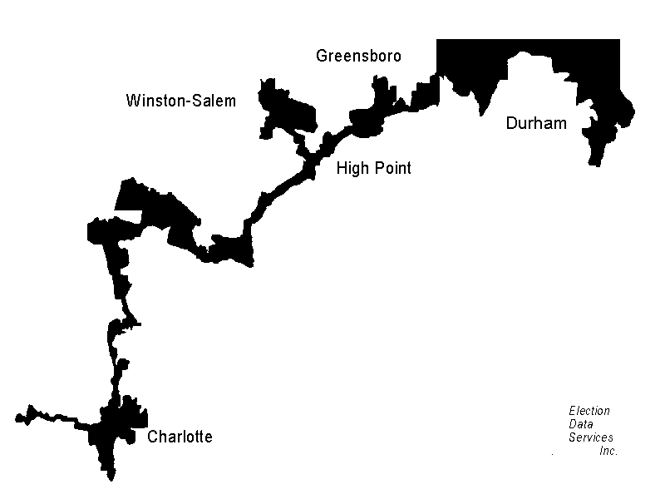
Vocab Check
Populations of several cities
linked together in this district
Gerrymandering
What is the difference between redistricting and gerrymandering?
Notes:
Gerrymandering- the dividing of a state, county, etc., into election districts so as to give one political party a majority in many districts while concentrating the voting strength of the other party into as few districts as possible.
Franking privilege- The right of members to post mail to constituents without having to pay postage. A copy of the member’s signature replaces the stamp on the envelope. Authentic signatures of famous individuals are valuable collectors’ items. Franking Privileges is one of the reasons incumbents often win
Do Americans reelect their representatives because they agree with their voting record? Hardly. Only 11% of Americans have any idea of how their representatives voted on a given issue. If not policy, what gives incumbents their electoral advantage?
Incumbents have an advantage in visibility. They can use the congressional franking privilege to sent mailings to constituents, and they take advantage of telephone and email technology to maintain contact with constituents.
Incumbents can also claim credit for services to individual constituents, called casework, as well as for pork barrel projects in their constituencies. This is safer than taking credit for policy changes because those win enemies as well as supporters.

Slide 8
Remember the effects of Gerrymandering?
Adds to advantage of majority party and incumbents
Decreases voter choices to influence make-up of the legislative branch
Increases party polarization
Reduces descriptive representation

Slide 9
Powers of Congress
Article I: Enumerated and Implied

Slide 10
Review: Power of the Purse
No money can be drawn from the U.S. treasury without approval of Congress
Congress…
Appropriates public money
Raises taxes
Each House…
Has Appropriation and Budget committees

Slide 11
What’s the Difference Between Enumerated and Implied Powers?
Enumerated Powers
Implied Powers
Expressed means that they are explicitly written in the Constitution, giving Congress the direct power to regulate those areas
Implied means that they are powers taken by Congress through reasonable deduction from the enumerated powers
The “Necessary and Proper” Clause

Slide 12
The Power to Regulate Interstate Commerce
Enumerated
implied
“to regulate Commerce with foreign Nations, and among the several states, and with the Indian Tribes”
The Congress can make laws regulating domestic and foreign trade
Cannot favor one state over another
Establish a minimum wage
Ban discrimination in workplaces and public facilities
Pass laws protecting the disabled
Regulate Banking

Slide 13
SCOTUS Case, Enumerated Power
Gibbons v. Ogden ruling makes a loop hole giving Congress power to take control over any issue involving the movement of people, or things
Ogden had a state license to operate in the Hudson River
Gibbons saw potential profit from multiple states and obtained a federal license to operate on the Hudson River
Gibbons won- which increased Federal power (in the context of Federalism)
Notes:
This was also a federalism case

Slide 14
The Power to Borrow Money
Enumerated
Implied
“to borrow money on the credit of the United States”
No limit on how much we can borrow
No limitations on the reasons for borrowing
The power to establish the Federal Reserve System of Banks

Slide 15
SCOTUS Case: Implied Powers
McCulloch v. Maryland (1819)- REQUIRED CASE-
Could Congress form the National Bank, when it was not an enumerated power?
The Court upheld the use of implied powers (elastic clause) and the supremacy of federal law
Implied powers from “coin money,” “borrow money,” “collect taxes,” “determine laws on bankruptcy,” and “punish counterfeiting.”

Slide 16
The Power to Raise an Army and Navy
Enumerated
implied
Congress alone has the power to raise and support an Army and Navy
Make rules governing our military
Declare War
The power to draft Americans into the military
Highly controversial, but upheld by Supreme Court in 1917

Slide 17
The Power to Create Naturalization Laws
Enumerated
Implied
“To establish an uniform Rule of Naturalization.”
Congress set up the process for immigrants becoming citizens
The power to regulate and limit immigration
Quotas are placed on the number of people that can immigrate here every year

Slide 18
The Power to Establish Post Offices
Enumerated
Implied
“to establish Post Offices and Post roads”
Provides for the carrying of the mail
“Post Roads” include rail lines, airways, and waters in US while mail is travelling on them
Prohibit mail fraud and obstruction of the mail
Bar the shipping of certain items through the mail

Slide 19
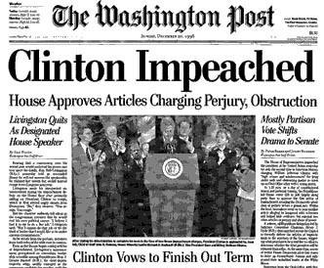
Duties of Each House
House only duties
Originate revenue bills
though all bills must be approved in both houses, they must originate in the House
Power of impeachment
power to charge the president, vice-president, federal judges, and other national officials with serious crimes
Senate only duties
Senate acts as court in cases of impeachment (2/3 vote to convict and remove from office)
Confirm presidential appointments
federal judges and justices, cabinet posts, ambassadors
Approve treaties by a 2/3 vote

Slide 20
What’s the best way to reach your Congressperson or Senator if you are wanting a bill to be passed (or blocked)?

Slide 21
Notes:
Because claiming credit may be important for reelection, members of Congress rarely pass up the opportunity to increase federal spending in their state or district.
The Big Dig in Boston is an example of an expensive earmark for which members of Congress could claim credit.
So let them know how you feel about what they are doing!

Slide 22
Policy Making
Structures and Processes

Slide 23
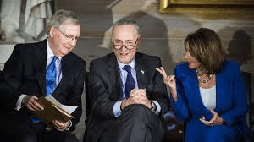
AP Government Legislative Leadership

Slide 24
Leadership Positions in the House
Speaker of the House – presiding officer of the House of Reps. who is the leader of the majority party
Majority Leader – helps the Speaker guide the party’s policy program through the legislative process- leads debates
Majority Whip – keeps track of the vote count and rallies support for legislation on the floor
Minority Leader – leads the minority party and champions its causes in the House
Minority Whip – same role as that of the majority whip, but for the minority party
Speaker of the House
Majority Leader
Minority Leader
Majority Whip
Minority Whip

Slide 25
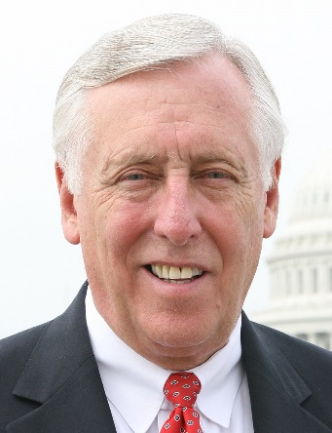
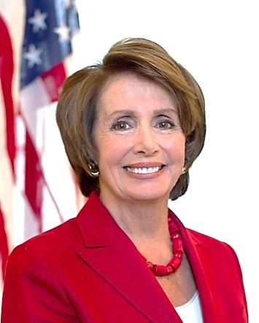
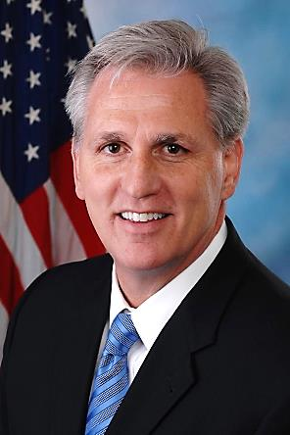
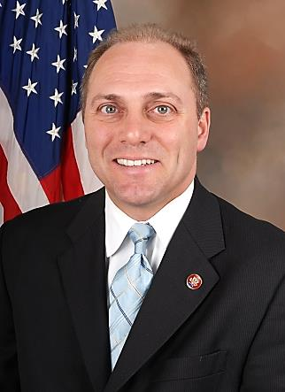
House Leadership
Majority Leader
Rep. Steny Hoyer
(D) Maryland
Minority Leader
Rep. Kevin McCarthy
(R) California
Speaker of the House
Rep. Nancy Pelosi
(D) California
Majority Whip
Rep. Jim Clyburn
(D) South Carolina
Minority Whip
Rep. Steve Scalise
(R) Louisiana
Notes:
Speaker of the House is chosen by the whole House in a vote
Separate parties determine their own leadership
Leaders- lead debate
Whips- in charge of keeping their parties in line, keeps track of how each member of their party will vote on issues

Slide 26
Leadership Positions in the Senate
Senate has majority and minority leaders and whips, just like the House
The presiding officer of the Senate is the Vice President who makes tie-breaking votes
President pro tempore is generally the majority party Senator with the most seniority who presides over the Senate in the absence of the Vice President
Majority Leader doesn’t preside over the Senate, but does schedule legislation on the floor and steers negotiations with the minority party
Vice President of the United States
President
Pro Tempore
Majority Leader
Minority Leader
Majority Whip
Minority Whip

Slide 27
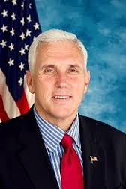
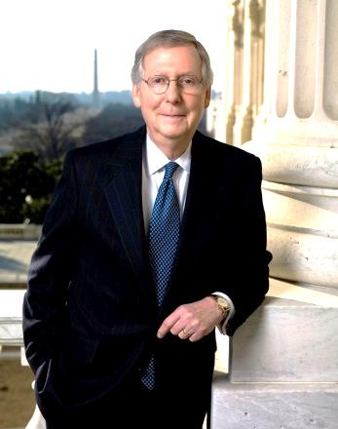
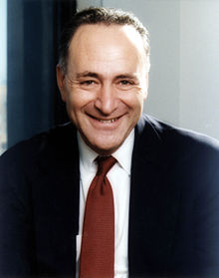
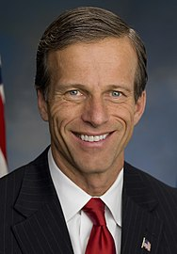
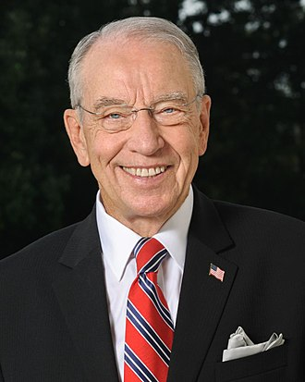
2019 Senate Leadership
Majority Leader
Sen. Mitch McConnell
(R) Kentucky
Minority Leader
Sen. Chuck Schumer
(D) New York
Vice President
Vice President
Mike Pence
(R) Indiana
Majority Whip
Sen. John Thune
(R) South Dakota
Minority Whip
Sen. Richard Durbin
(D) Illinois
President pro tempore
Sen. Chuck Grassley
(R) Iowa

Slide 28
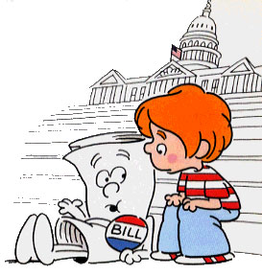
Committees and Lawmaking

Slide 29
Committees
Standing Committees of the
House of Representatives
Agriculture
Appropriations
Armed Services
Budget
Education and the Workforce
Energy and Commerce
Ethics
Financial Services
Foreign Affairs
Homeland Security
House Administration
Intelligence (Permanent Select)
Judiciary
Natural Resources
Oversight and Government Reform
Rules
Science, Space, and Technology
Small Business
Transportation and Infrastructure
Veterans' Affairs
Ways and Means
standing committee
a permanent congressional committee that specializes in a particular policy
most of the drafting of legislation takes place here
16-20 Senators on each, and an average of 42 members on each in the House
majority party has a majority in each committee and has the chair
subcommittee
formed from topics relating to standing committees
Notes:
Committees allow for specialization on a few topics for each member

Slide 30
Power of Committees
Which ever party holds power,
Holds the majority of seats on each committee
holds the flow of legislation (each bill must pass through committee)
Senate
Holds confirmation hearings but first
They often sit privately with committee
Example, nomination for Secretary of Defense must clear the Armed Services committee first

Slide 31
Committees
Joint committee
made up of members of both the House and Senate that is concerned with a specific policy area (Joint Economic Committee)
Select or Special committee
A temporary congressional committee created for a specific purpose and disbanded after purpose is fulfilled (investigations into Watergate, Benghazi)
Notes:
Joint Committee Examples-
The joint committees are made up of both senators and representatives. They typically have an oversight or policy role but no legislative duties.
Commission on Security and Cooperation in Europe
Joint Committee on Printing
Joint Committee on Taxation
Joint Committee on the Library
Joint Economic Committee

Slide 32
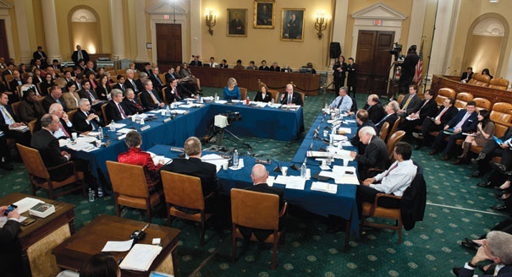
Conference Committees
Conference committees
A temporary committee created to work out differences between the House and Senate versions of a bill
Notes:
Other ways to create a singular version of a bill to pass both houses:
informal negotiations between committee leaders in the House and Senate resolve differences
leaders of the majority party of both houses (when one party controls both houses) come up with a compromise bill without the help of the other party

Slide 33
Nongovernmental Groups
Caucuses
Like-minded people in Congress, usually around one topic
Usually one group in the House and one in the Senate
Support Staff
Senators employ about 40/each
House members about 17/each
Various titles and responsibilities

Slide 34
House Only Committees and Procedures
Ways and Means
Determines tax policy
Rules Committee
Defines guidelines for floor debates
Can alter standing rules
How many amendments are allowed
Discharge petition
Can bring a bill out of reluctant committee
Simple majority

Slide 35
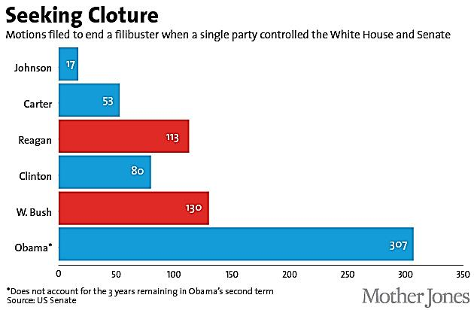
Senate Only Rules and Procedures
Much less centralized and hierarchical than the House
Smaller size
Anyone may be recognized to speak
Bills
Amendments do not need to be germane
Filibuster
No bathroom breaks
Cannot sit down
Cannot stop talking
Cloture rule
60 votes brings a filibuster to an end

Slide 36
Key Differences

Slide 37
Legislative process
Introducing and Amending Bills

Slide 38
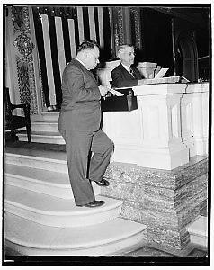
Lawmaking Process Begins
A bill must first be introduced into one of the houses of Congress
In the House it is introduced by a member dropping it into the hopper (a mahogany box near the rostrum where the Speaker presides)
In the Senate it is introduced by giving it to a Senate clerk, or by introducing it from the floor

Slide 39
Congressional Agenda
Issues can reach the congressional agenda through many ways
A highly visible event focuses national attention on it
Media attention or new technology can do it
Congressional leaders (party leaders or committee chairs) can move issues onto the agenda
Notes:
Some issues are always on the agenda, such as foreign aid, national debt, Social Security, etc.

Slide 40
How does a bill become a law?
Party polarization and divided gov’t has led to fewer bills being passed by Congress

Slide 41
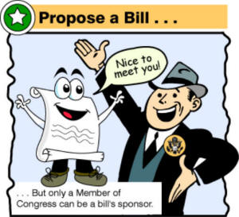
Step 1
INTRODUCTION
A bill needs to be introduced into both houses of Congress (the Senate and the House of Representatives)

Slide 42
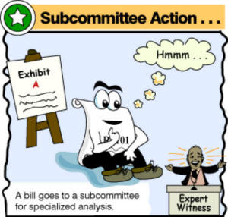
Step 2
The introduced bill then is sent to the appropriate standing committee within the House and the Senate (a bill on education goes to the Education Committee)
Before the whole committee works on it, the bill goes to the appropriate subcommittee within the standing committee
If passed through the subcommittee, then the standing committee then debates on the bill, rewrites it and votes whether it approves it (if they don’t approve it the bill “dies” in committee)
COMMITTEE
ACTION

Slide 43
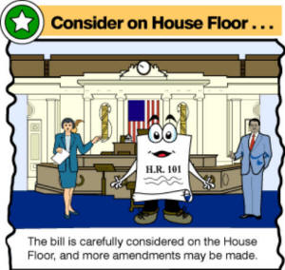
Step 3
Once the bill is approved by the committee it is in it goes to the whole House and the whole Senate
IN THE HOUSE ONLY: before it goes to the floor it has to go to the Rules Committee to set rules for debate on the floor
The whole House and Senate then debate the bill and vote on whether they approve it
FLOOR ACTION

Slide 44
Step 4
Once the House and Senate approve their versions of the bill it is likely that the two versions are different.
If they are different then a committee of members from both the House and the Senate come together and work out a single version of the bill that is a compromise between the original two versions
CONFERENCE COMMITTEE

Slide 45
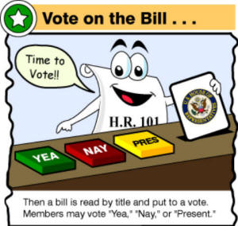
Step 5
FINAL APPROVAL
The single version of the bill agreed upon by the conference committee then goes back to the whole House and the whole Senate for approval

Slide 46
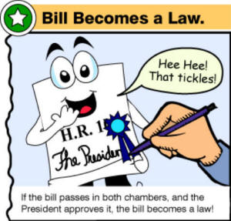
Step 6
When the two houses of Congress pass a single version of a bill it goes to the President.
The President can either sign the bill and it becomes law or he/she can veto it.
PRESIDENTIAL
ACTION

Slide 47
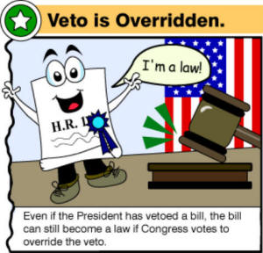
Step 7
If the President vetoes a bill then Congress can over-ride the veto so the bill so it can become a law.
To do so requires a 2/3 vote in favor of the bill in both the Senate and the House.
OVERRIDE A VETO

Slide 48
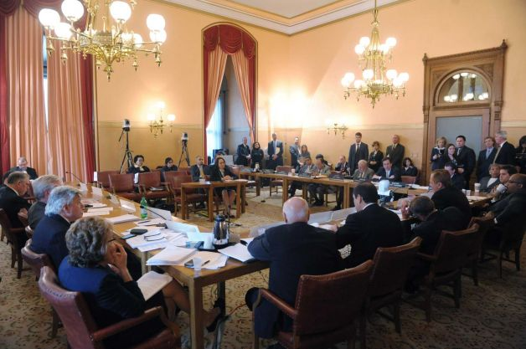
Definitions
seniority
years of consecutive service
important when it comes to committees (expertise on the ones you are on, and ability to move to more important ones)
markup sessions
meetings in which committees and subcommittees actually debate and amend bills

Slide 49
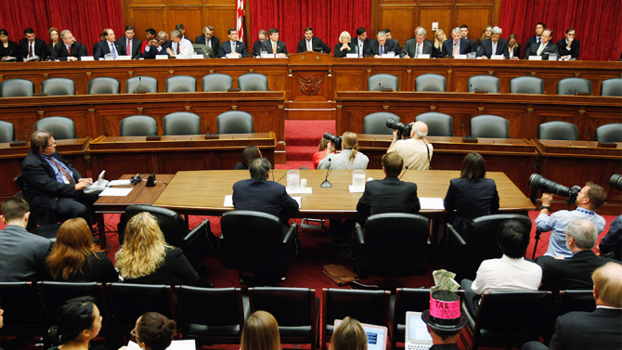
Definitions
Logrolling
Trading votes to gain support for a bill
oversight
the process of reviewing the operations of an agency (within the executive branch) to determine whether it is carrying out policies as Congress intended
Notes:
it is done by committees that hold hearings, request reports, or have committee members discuss issues with agency officials
sometimes it is seen as lawmakers trying to show the faults of the agency or executive branch
more often it is done as it is helpful to committee members as they try to pass new legislation that is more effective

Slide 50
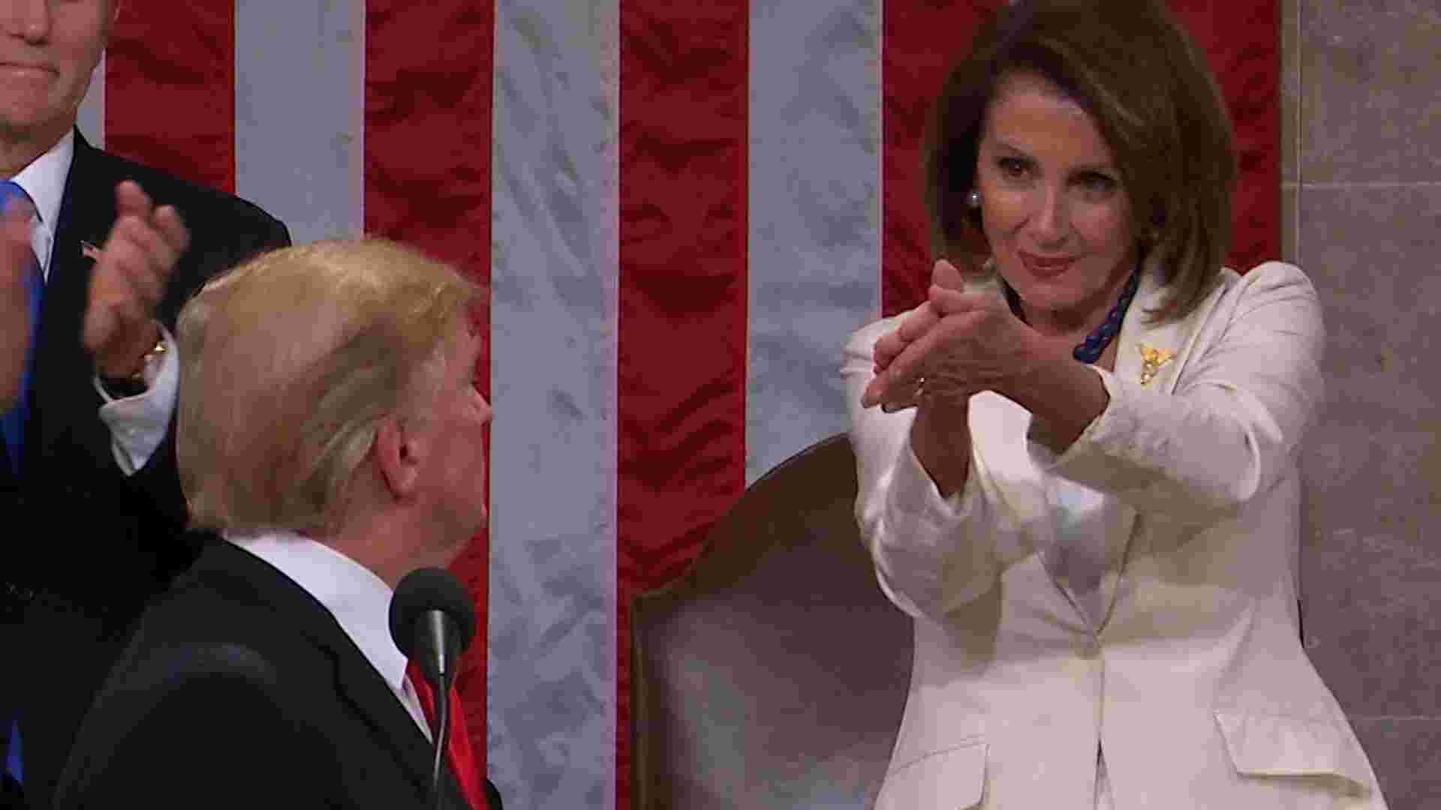
Influences on Lawmaking Process
Political parties
National political parties lost power to nominate candidates and candidates get more funding support from individuals than the party
Still, the leadership of the parties strongly control the votes of members of Congress
The President
As a person elected by the whole nation the president can claim to represent the entire nation more than members of Congress do
Presidents campaign on what they will do when elected so they play an active role in lawmaking
White House writes bills and guides them through the law-making process in Congress

Slide 51
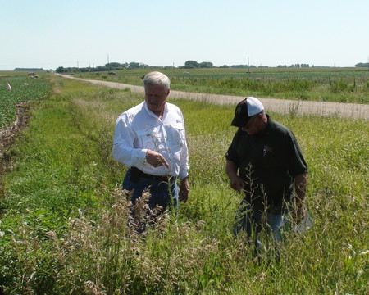
Influences on Lawmaking Process
Constituents
Law-makers are always influenced by their constituents as they are always worried about getting reelected
Members of Congress give higher priority to stances on issues that their constituents care strongly about (agricultural issues important for a Congressman from Iowa)
Interest groups
Interest groups represent a vast array of groups in society and press members of Congress to take certain actions
Members of Congress listen as the interest groups represent segments of their constituents, and many provide campaign funding
Lobbyists also provide detailed information to members of Congress about issues

Slide 52
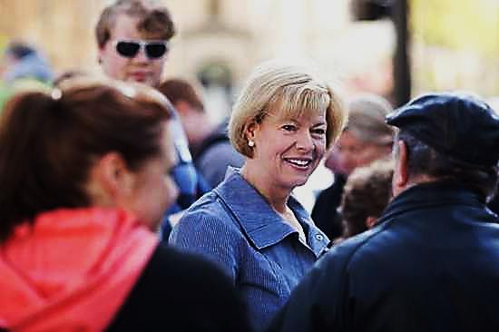
Congress Representation of Constituents
No rule governs what a representative must base their votes on in Congress
Delegate Model
Most popular in the House, members try to vote to reflect their constituency. They may hold town hall meetings to discuss big legislation
Trustee model
Most popular in the Senate, Legislatures believe their constituency entrusted them to use their best judgement
Politico Model
Attempts to blend the previous 2 models. This model considers a variety of factors, least of which is overall public opinion
Often times political party considerations and national interests trump the views of constituents when a member of Congress decides on how to vote on a bill
Former Rep. Paul Ryan and Sen. Tammy
Baldwin talk to constituents

Slide 53
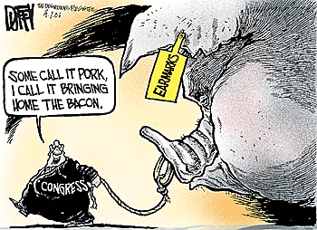
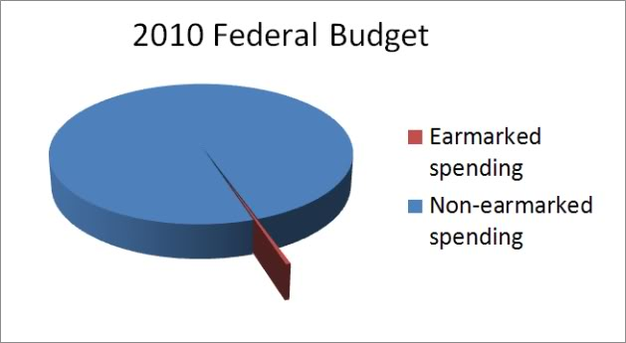
Earmarks
Earmarks
Federal funds appropriated by Congress for use on local projects
They are often added to appropriations bills
They are designed to help the representative whose district will benefit from the project

